Slide 1
Lecture 10
Activity Selection Problem

Slide 2

Activity Selection Problem
Input: A set of activities S = {a₁,…, a_{n}}
Each activity has start time (s_{i}) and a finish time (f_{i}) a_{i}=(s_{i}, f_{i})
Two activities are compatible if and only if their interval does not overlap.
Output: A maximum-size subset of mutually
compatible activities.

Slide 3
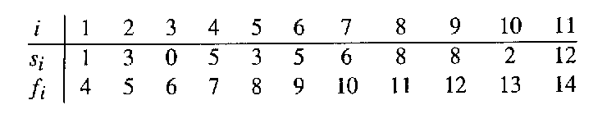
Example: Activity Selection
Here are a set of start and finish times:
What is the maximum number of activities that can be completed?
{a₃, a₉, a₁₁} can be completed.
But so can {a₁, a₄, a_{8’} a₁₁}, which is a larger set.
But it is not unique, consider {a₂, a₄, a_{9’} a₁₁} .

Slide 4
Activity Selection: A Greedy Algorithm
The greedy solution is simple:
Sort the activities by finish time.
Schedule the first activity.
Then schedule the next activity in sorted list which starts after previous activity finishes.
Repeat until no more activities.

Slide 5
0 1 2 3 4 5 6 7 8 9 10 11 12 13 14 15

Slide 6
0 1 2 3 4 5 6 7 8 9 10 11 12 13 14 15

Slide 7
0 1 2 3 4 5 6 7 8 9 10 11 12 13 14 15

Slide 8
0 1 2 3 4 5 6 7 8 9 10 11 12 13 14 15

Slide 9
0 1 2 3 4 5 6 7 8 9 10 11 12 13 14 15

Slide 10
0 1 2 3 4 5 6 7 8 9 10 11 12 13 14 15

Slide 11
0 1 2 3 4 5 6 7 8 9 10 11 12 13 14 15

Slide 12
Solution
Activities selected: {a₁, a₄, a_{8’} a₁₁}

Slide 13
Algorithm: Activity Selection
Sort the input activities by increasing finishing time (f₁ ≤ f₂ ≤ . . . ≤ f_{n})
n = length [s]
A={i}
j = 1
For i = 2 to n
do if s_{i} ≥ f_{j}
then A= AU{i}
j = i
Return A

Slide 14
Complexity Analysis
Sorting the activities on the basis of finishing line = O(nlgn)
For loop in the algorithm = Ɵ(n)
Overall Complexity:
When activities are sorted by their finish time: O(N)
When activities are not sorted by their finish time, the time complexity is O(N log N) due to complexity of sorting.

Slide 15
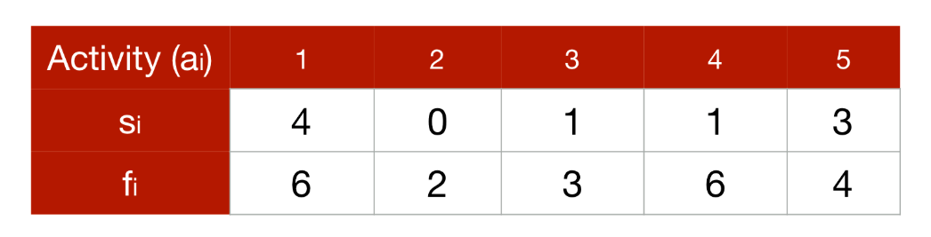
In Class Practice
Ques: Look at the following table containing activities, and their start and end time.
Here, s_{i} and f_{i} are the starting and the finishing time of the activity a_{i}.

Slide 16
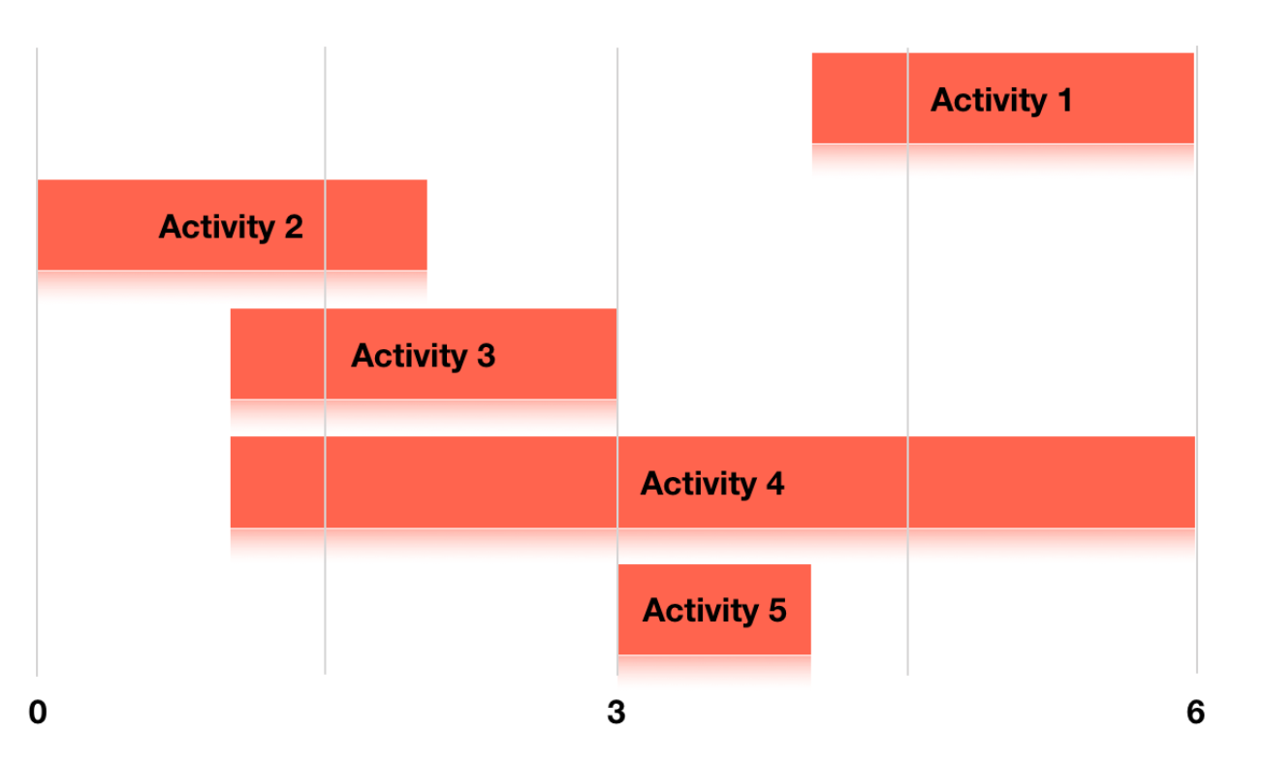
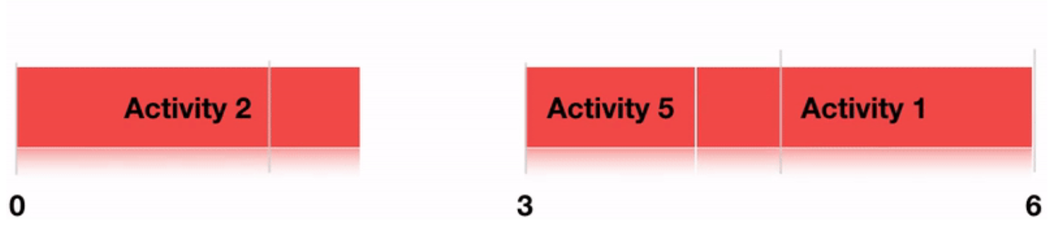
Solution

